Slide 1
DIFFERENTIAL GPS BASICS
By
CULTON MOYO

Slide 2
AGENDA
Control Surveys
GNSS
Field Corrections
DGPS setups
Procedure for corrections

Slide 3
Control Surveys

Slide 4
establishing a network of points with known positions to provide a reference for other surveying works. They fall into 3 categories:
Horizontal Control Surveys:
These surveys are used to establish the precise locations (latitude and longitude (x, y)) of points on the Earth's surface. typically using techniques such as triangulation, trilateration, resection, or (GNSS) etc.
Vertical Control Surveys:
These surveys establish the elevations (heights) of points within a survey area.
3D Control Surveys:
These combine both horizontal and vertical measurements to create a three-dimensional network of points.

Slide 5
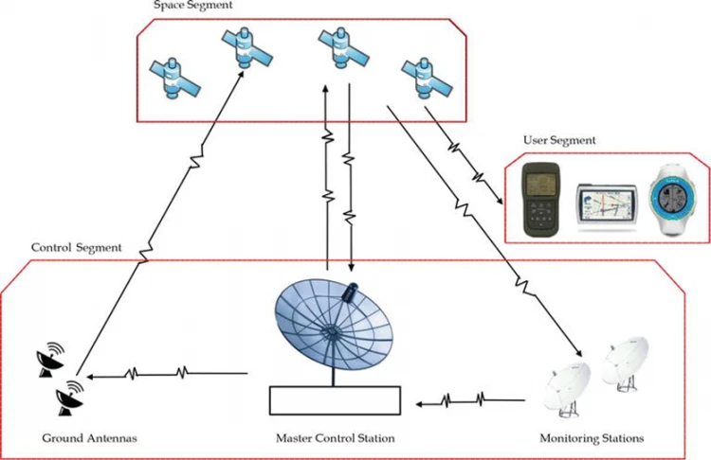
Global Navigation Satellite Systems (GNSS)

Slide 6
Global Navigation Satellite Systems (GNSS)
GNSS surveying methods uses satellite signals to determine precise coordinates, enabling accurate measurements to a certain level depending on the method used. Methods of GNSS include Single point positioning, differential positioning etc.

Slide 7
Single Point Positioning (SPP)
Single Point Positioning is the most basic form of GNSS surveying, where a single receiver collects satellite signals to determine its position. However, SPP has limitations in terms of accuracy, typically within a few meters due to factors like atmospheric interference and satellite geometry. E.g Handheld GPS, phones.
Accuracy 5m to 10m

Slide 8
Differential Positioning (DGPS)
Differential Global Positioning System improves accuracy by using a reference station with known coordinates. By comparing the reference station’s position with the receiver’s measurements, DGPS can eliminate errors caused by atmospheric disturbances, clock inaccuracies, and satellite orbit errors, achieving sub-meter to decimeter accuracy.

Slide 9
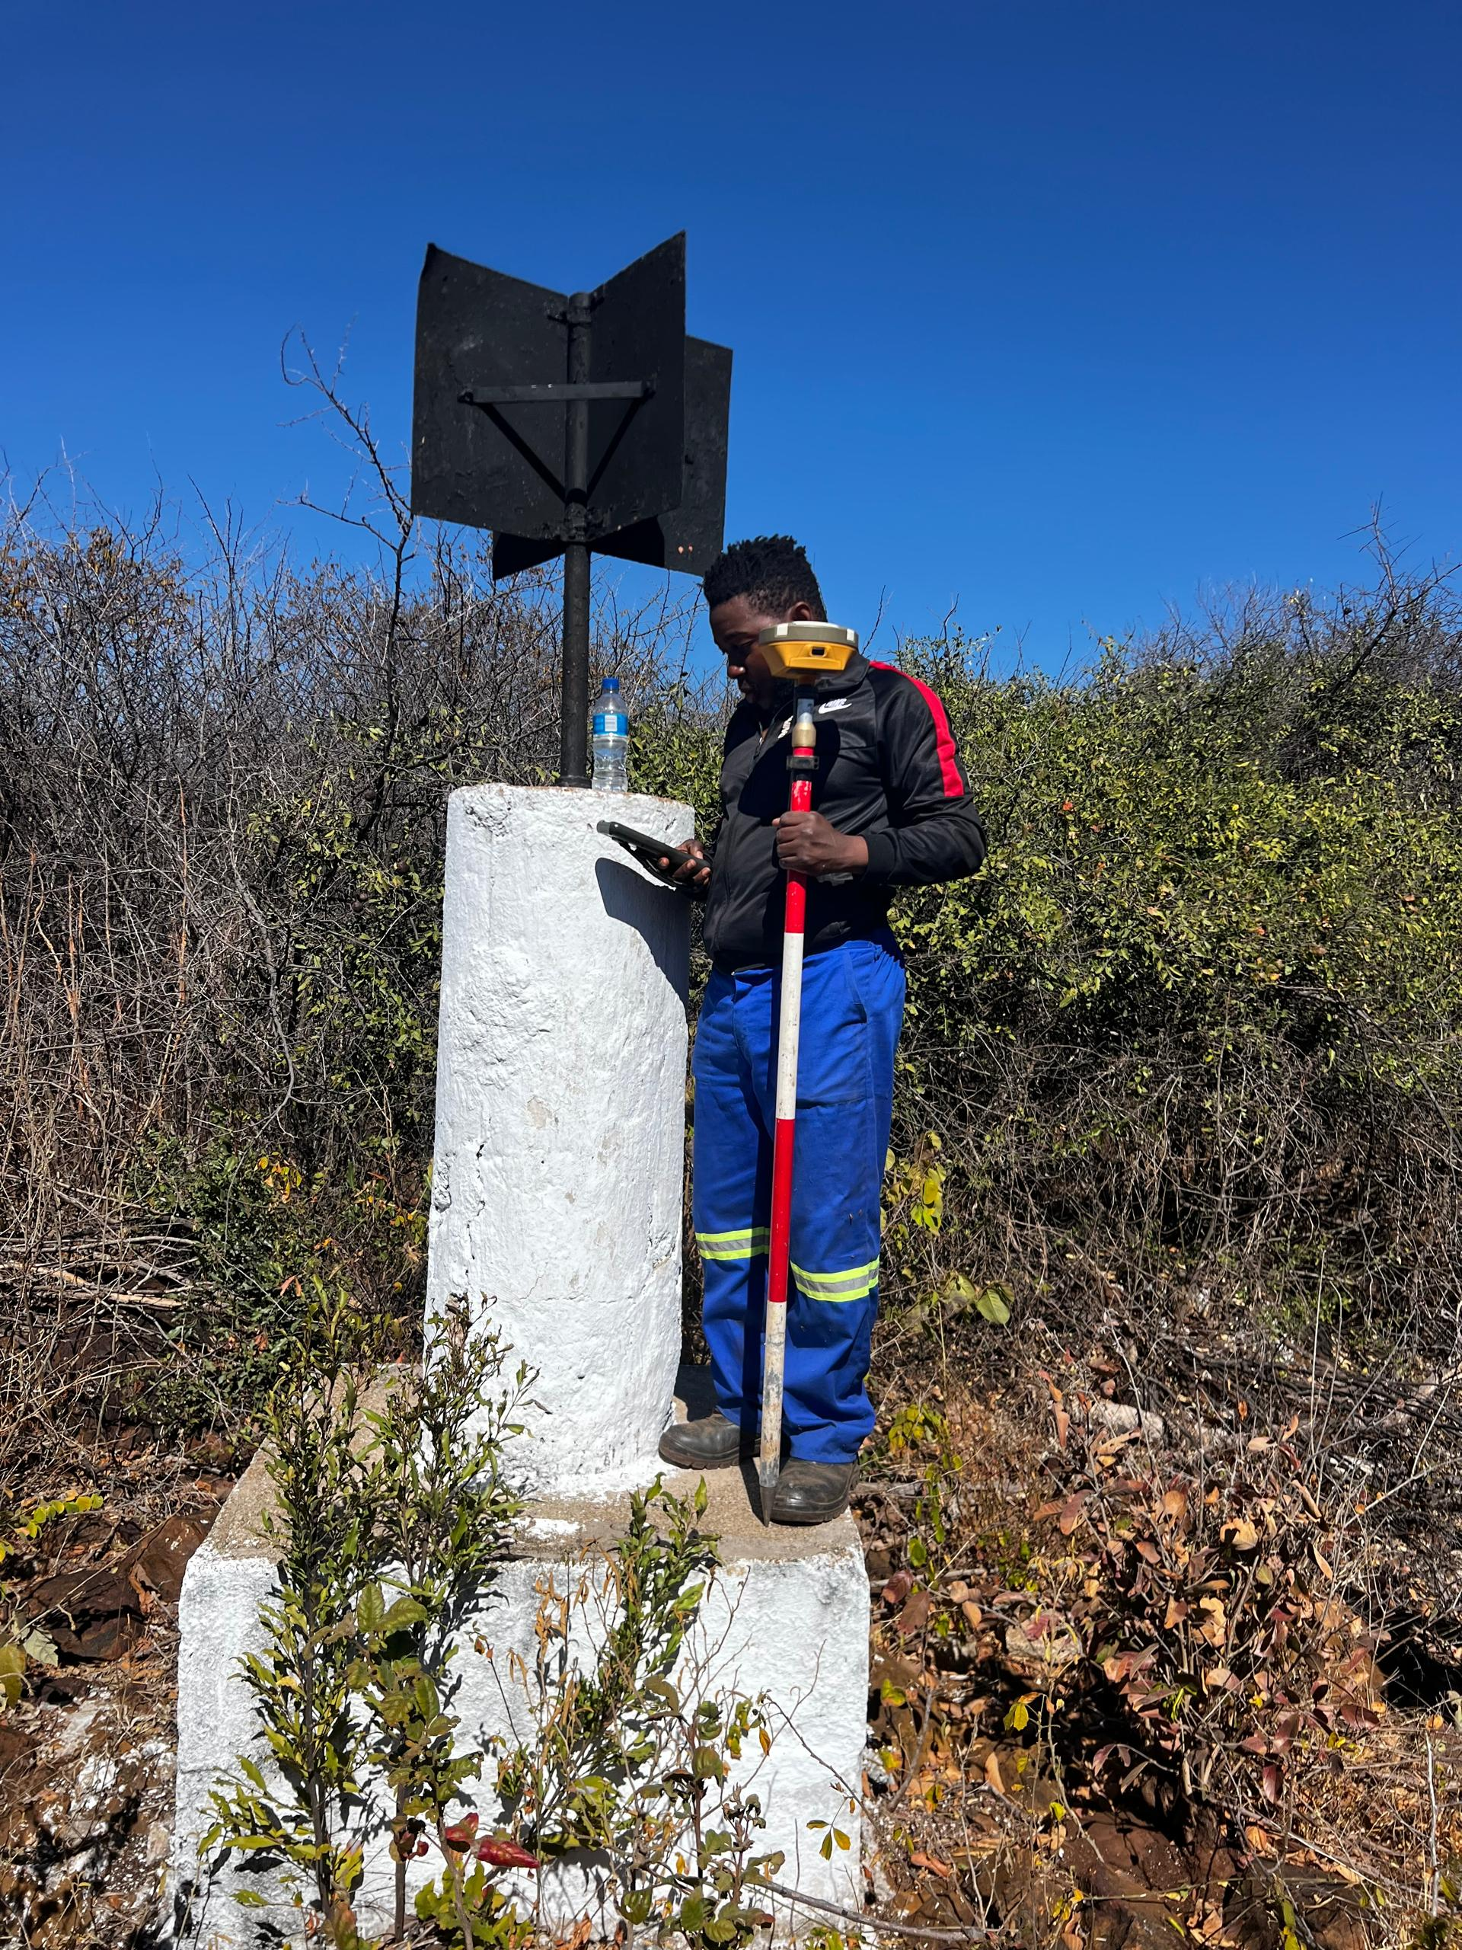
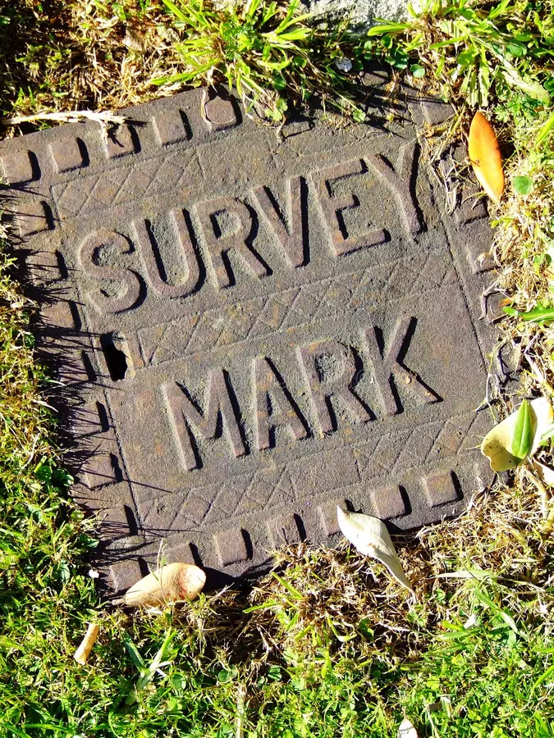
reference stations
Trig beacon
Ground control points

Slide 10
DGPS methods of establishing control points

Slide 11
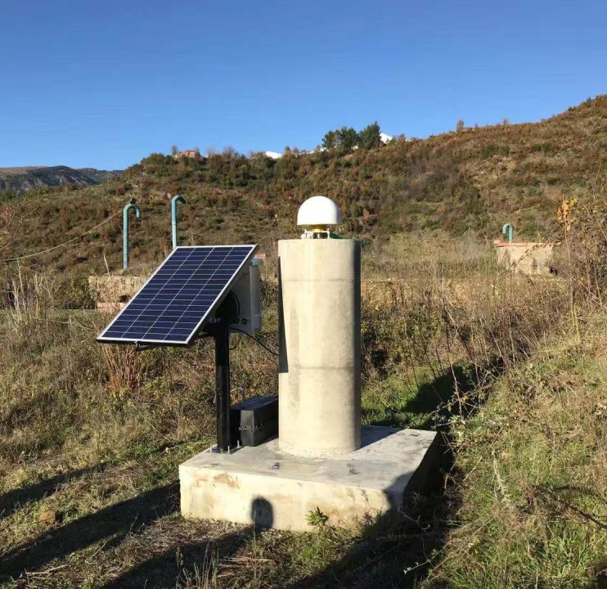
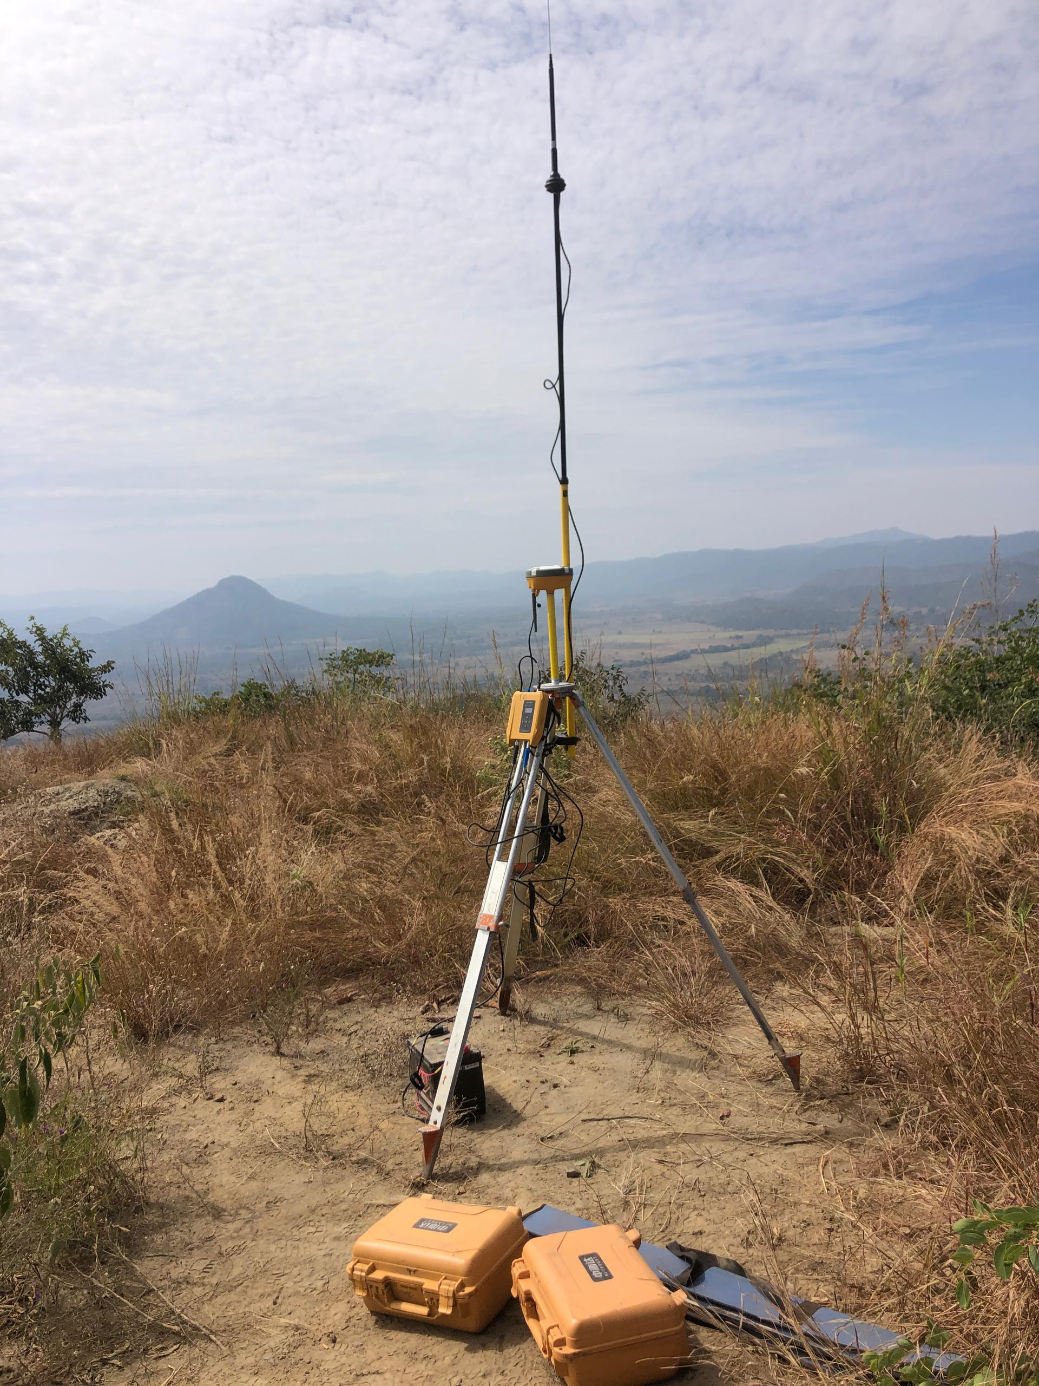
DGPS BASE stations TYPES
PERMANET BASE
TEMPORARY BASE

Slide 12
Static GPS Surveying
Involves a DGPS base station and a rover receiver at a fixed point for a longer period to collect data. The data is then processed after the survey to provide very accurate baseline coordinates. Ideal for complex environments with limited satellite visibility, in absence of stable RTK.

Slide 13
Real-Time Kinematic (RTK) Surveying
RTK is a surveying method that provides high-precision real-time positioning. It employs a base station and one or more rovers to receive GNSS signals. The base station receives signals from satellites and transmits correction data to the rovers, allowing them to compute precise coordinates. RTK can achieve centimeter-level accuracy, making it suitable for applications that demand high precision.
It uses a continuously broadcasting correction signal from a base station to a rover, allowing for real-time, centimeter-level precision. This is ideal for establishing control points on construction sites or for cadastral surveys.

Slide 14
Post-Processing Kinematic (PPK) Surveying
Similar to RTK in its ability to achieve high accuracy, but it involves post-processing the collected data after the survey is completed. Requires less time compared to static on data collection.
(HBC) Hi-target Business Center
(TBC) Trimble Business Center
Leica Infinity Office Software

Slide 15
FIELD ADJUSTMENTS/CORRECTIONS

Slide 16
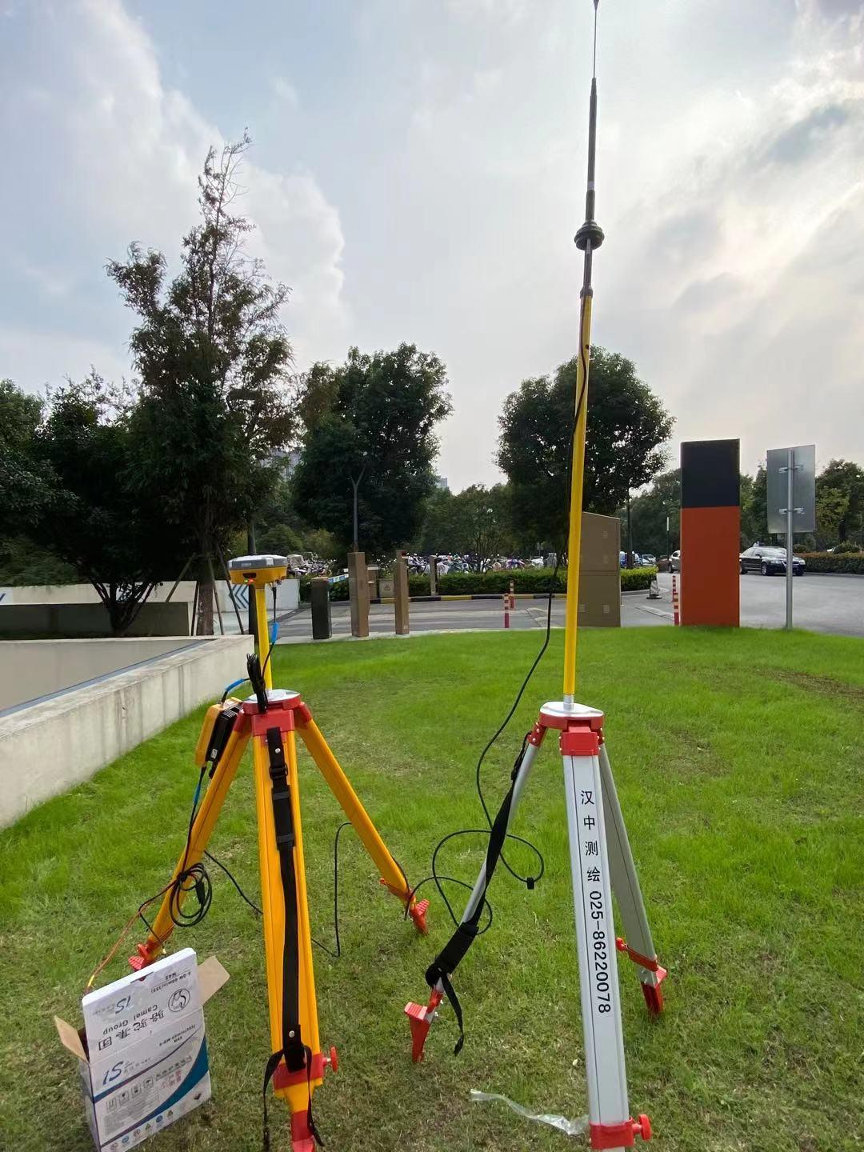
BASE correction and site calibration
Base correction involves a reference station at a known location calculating and broadcasting corrections for satellite signals to eliminate errors in a rover's position, typically over a specific geographical area.
A site calibration (or localization) is a separate process where a user defines a local grid system by observing known control points, then adjusts the system to match those specific, local coordinates

Slide 17
Base Correction
Purpose:
To correct for common errors (like atmospheric delays) affecting all GNSS receivers in an area by comparing the base station's known position to its measured position.
How it Works:
The base station calculates the difference (correction) between its true coordinates and its measured coordinates for each satellite. This correction is then broadcast to the rover, which applies it to its own measurements to improve accuracy.
Scope:
Corrections are valid over a limited geographical range, with accuracy degrading with distance from the base station.
When it's Used:
It's applied continuously or in real-time to the rover's position to achieve high accuracy.
Notes:
Can be used to stake points in real time (proposed claim)

Slide 18
Site Calibration (Localization)
Purpose:
To align a local project grid or coordinate system to known ground control points. It essentially localizes the global reference frame for a specific project.
How it Works:
The user collects coordinates for known, physical landmarks (control points) and inputs them into the GNSS software. The software then creates a transformation to match the observed coordinates to the project's specific grid, effectively "fitting" the local survey to the site.
Scope:
This is a localized process, creating a custom reference system for a particular site, not the global system.
When it's Used:
It's typically performed once at the start of a new project to establish the initial coordinate system and permanent controls for that site.
Notes:
Can be used to stake points in real time (proposed claim)

Slide 19
Key differences
Base correction
Site calibration
  It virtually shifts the position of the base station
  Provides accurate positions based on a global system
  Correction is ongoing for the duration of the survey.
  Depends on the accuracy of the fixed base station's location.
  Site calibration adjusts a local grid to match physical points.
  Aligns a local project to a local, defined grid.
  One-time setup for a new project.
  Depends on the accuracy of the observed local control points.

Slide 20
Base correction/ framework calibration
It is simply a translation/ vector (DX, DY, DZ).
A framework calibration is valid only if the controls and their target coordinates are in the same coordinate system.
Control point
rp
Translated point
Notes:
Needs at least 3 reference points and the project should be in between the reference points.

Slide 21
Site Calibration/ localization
rp2
rp3
It is not only a translation, there is also rotation and scaling.
Its relating two datums in a large locality.
They are 4 or 7 parameter transformations such as Bursa-Wolf or Molodensky.
project
rp1
Notes:
Needs at least 3 reference points and the project should be in between the reference points.

Slide 22
MAIN DGPS EQUIPMENT SETUPS
Notes:
BASE/ROVER and CORS setup

Slide 23
The key difference is that a Base/Rover setup uses a locally established base station, while a CORS (Continuously Operating Reference Station) setup uses a network of remote, permanent base stations to provide differential corrections. The CORS setup offers broader coverage, greater reliability, and improved accuracy by modeling regional atmospheric errors, whereas the local Base/Rover setup provides independence from internet connections and subscription fees but is limited by baseline distance and potential signal obstructions.

Slide 24
DGPS BASE stations TYPES
PERMANET BASE
TEMPORARY BASE

Slide 25
Local Base/Rover Setup
Components:
A single, temporary base receiver set up over a known point at the job site, and a rover receiver.
Corrections:
The base station collects data and transmits correction signals, typically via radio or cellular connection, to the local rover.
Pros:
  Independence: Doesn't rely on internet access or subscription fees.
  Potentially Higher Accuracy: A local base can provide more consistent results in some conditions, such as under tree canopy, by having the same view of the sky as the rover.
Cons:
  Distance Limitation: Accuracy degrades significantly with distance from the base station due to atmospheric errors, typically limiting baselines to 10-15 km.
  Setup Time: Requires time to set up and initialize the base station at each site.
Notes:
Vulnerability: more susceptible to communication outages or equipment failure

Slide 26
CORS Setup
Components:
A network of permanently installed, reference GNSS receivers spread across a geographic area that transmit corrections via the internet, often through an NTRIP (Networked Transport of RTCM via Internet Protocol) stream.
Corrections:
The rover receives corrections from the network, which uses multiple stations to model and account for distance-dependent atmospheric errors more precisely than a single base station.
Pros:
  Wide Coverage: Corrections are available over a large area.
  Improved Accuracy: Better error modeling for long distances due to the network of reference stations.
  Reliability: Less prone to single-point failure due to the distributed architecture and automatic data archival.
  No Site Setup: Eliminates the need to set up a base station at each project site.
Cons:
  Internet Dependency: Requires an internet connection for the rover.
  Subscription Fees: Access to CORS networks is often subscription-based.
  Potential for Reduced Satellite Availability: Due to greater distances, there may be fewer shared satellites between the network stations and the rover compared to a local base setup, affecting accuracy in certain scenarios.

Slide 27
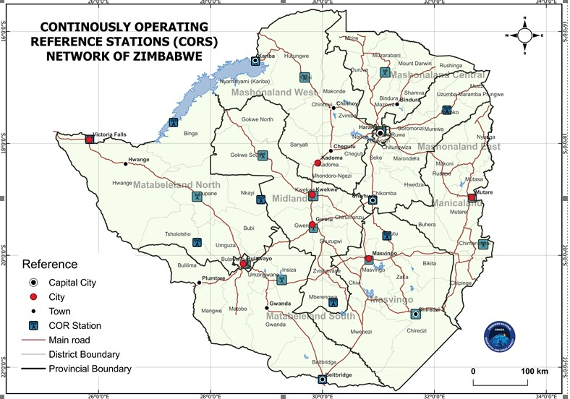
ZIMBABWE NATIONAL GEOSPATIAL and space agency (ZINGSA)
Notes:
25 CORs stations . Can reach ranges upto 100km in good conditions. Surveyor General and City of Harare also have supplementary CORS

Slide 28
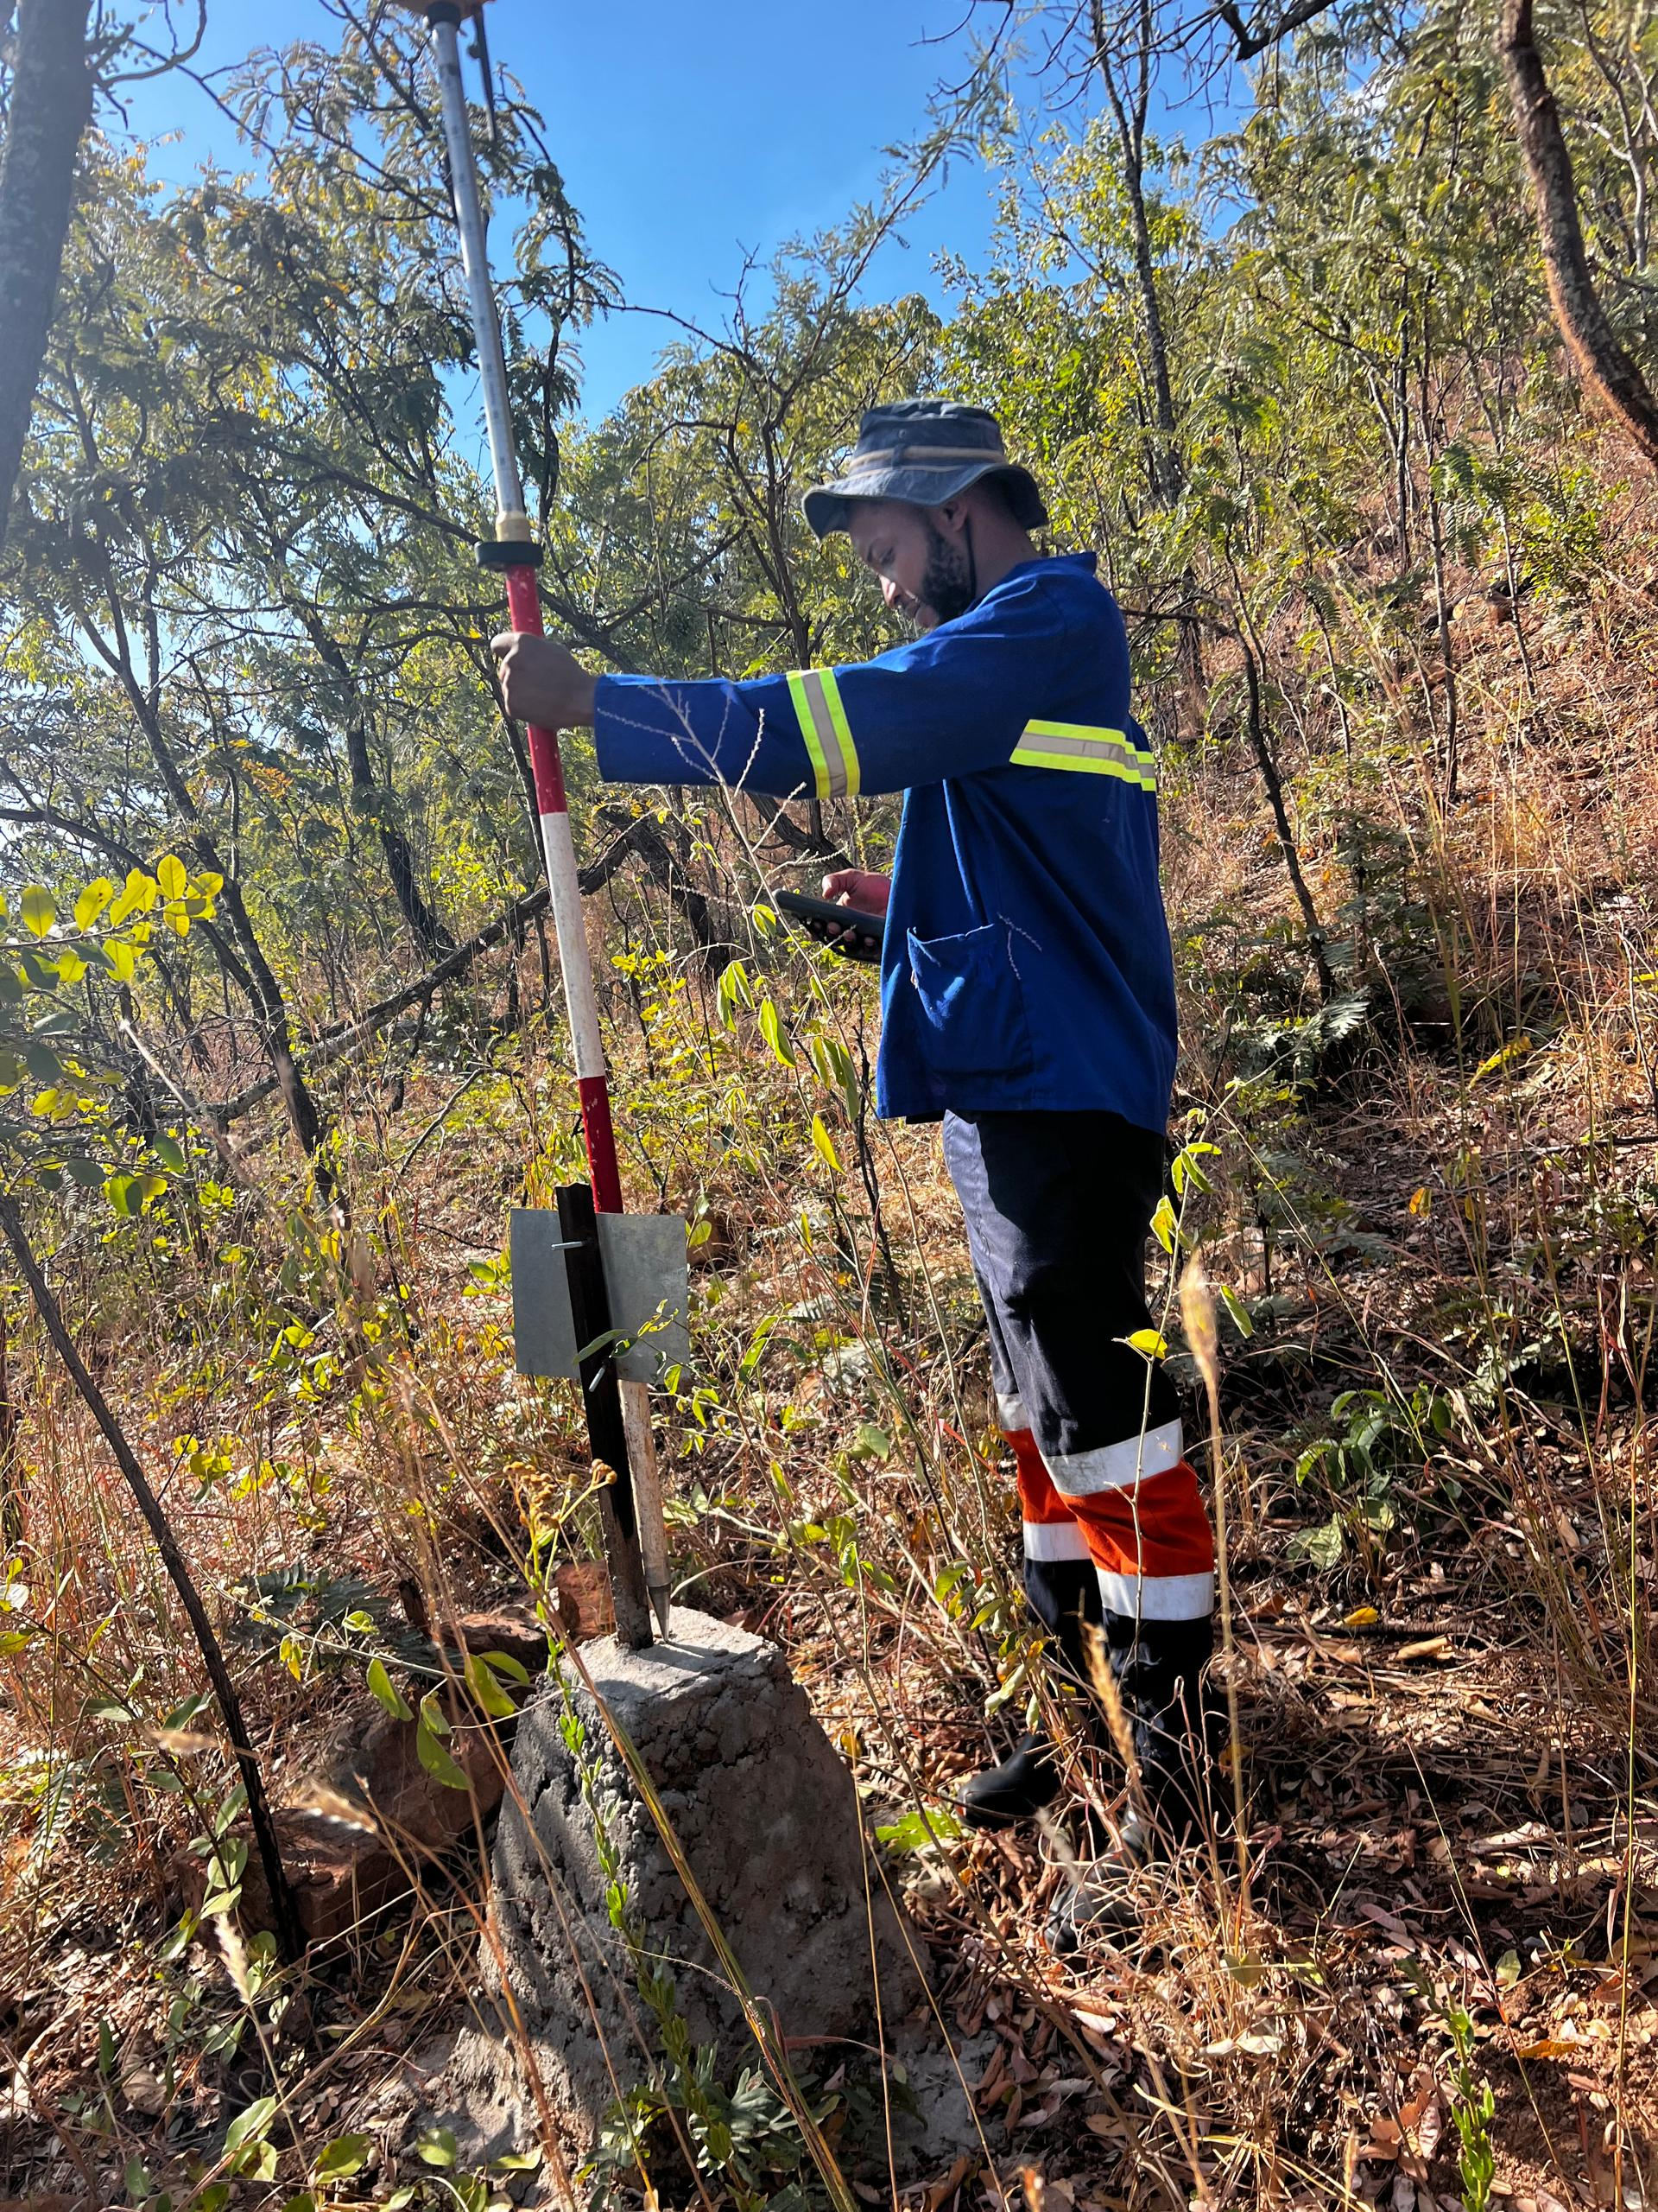
DGPS FIELD CORRECTION Procedures
(Hi-target)
Notes:
Ihand 30 controller

Slide 29
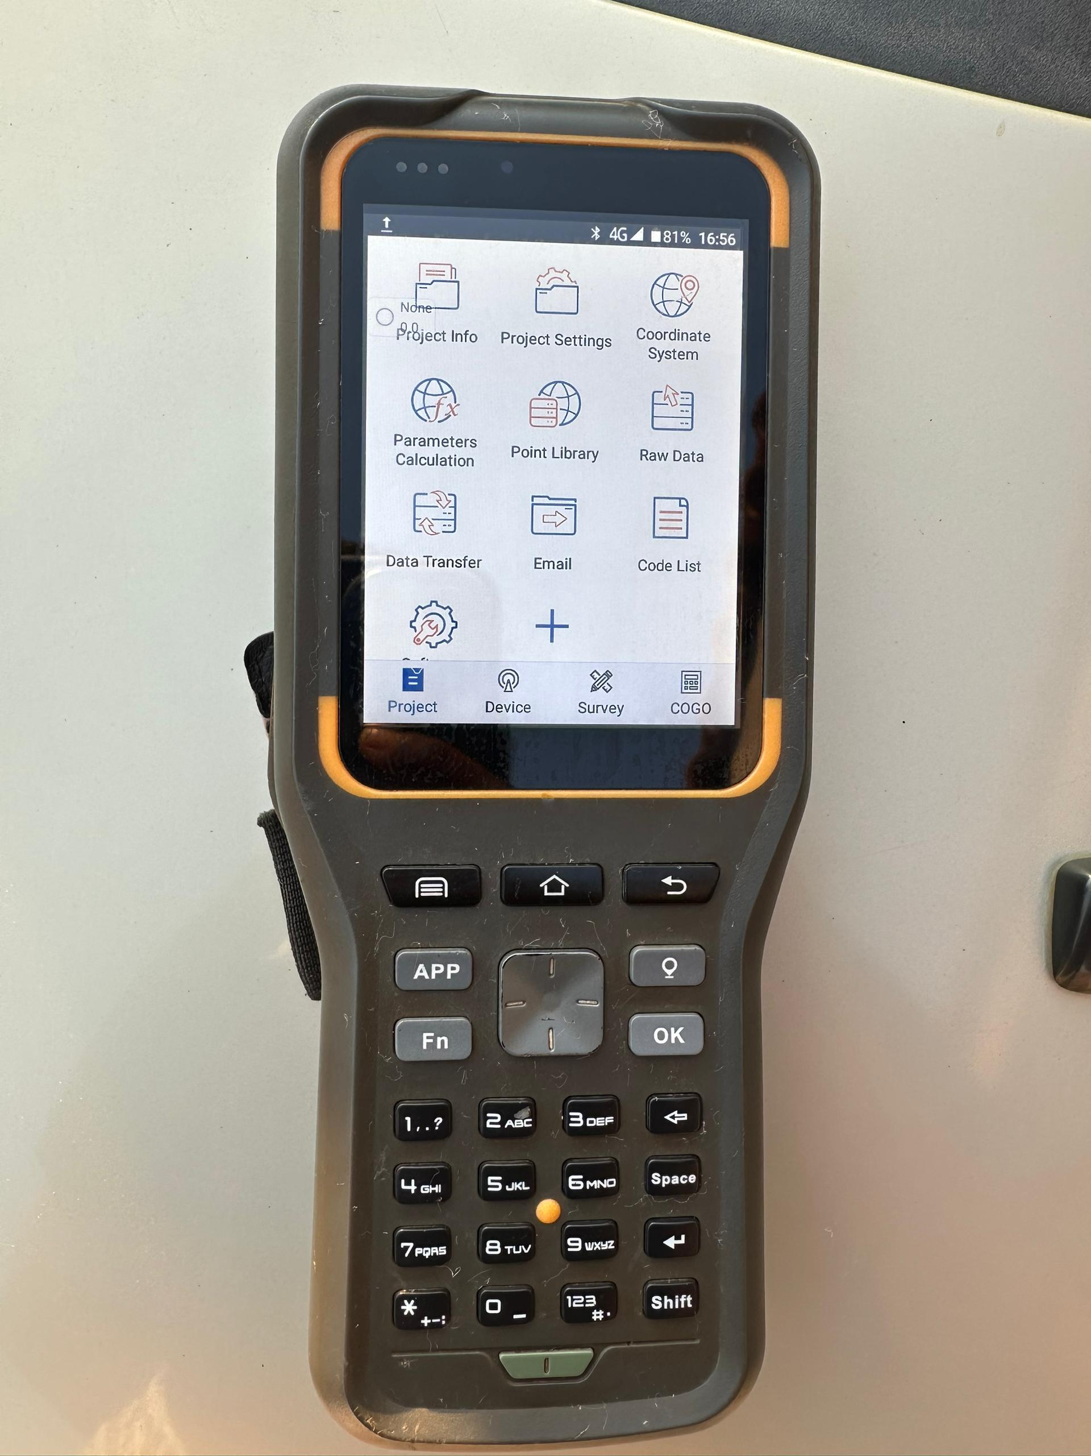
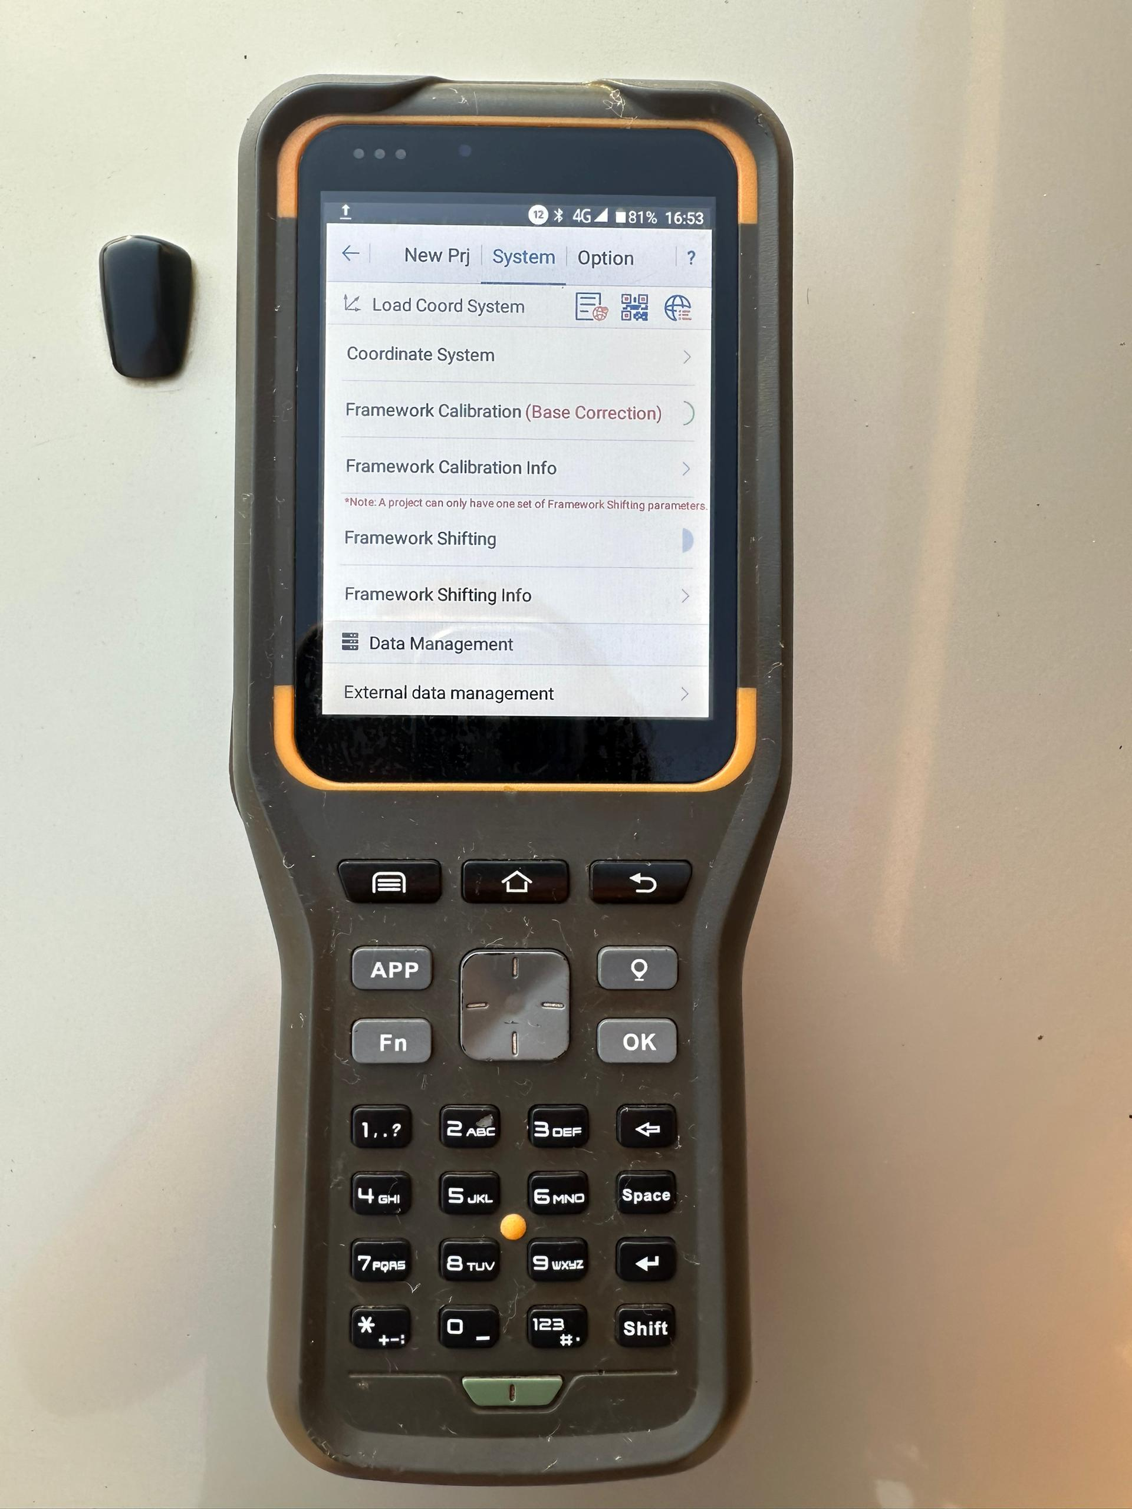
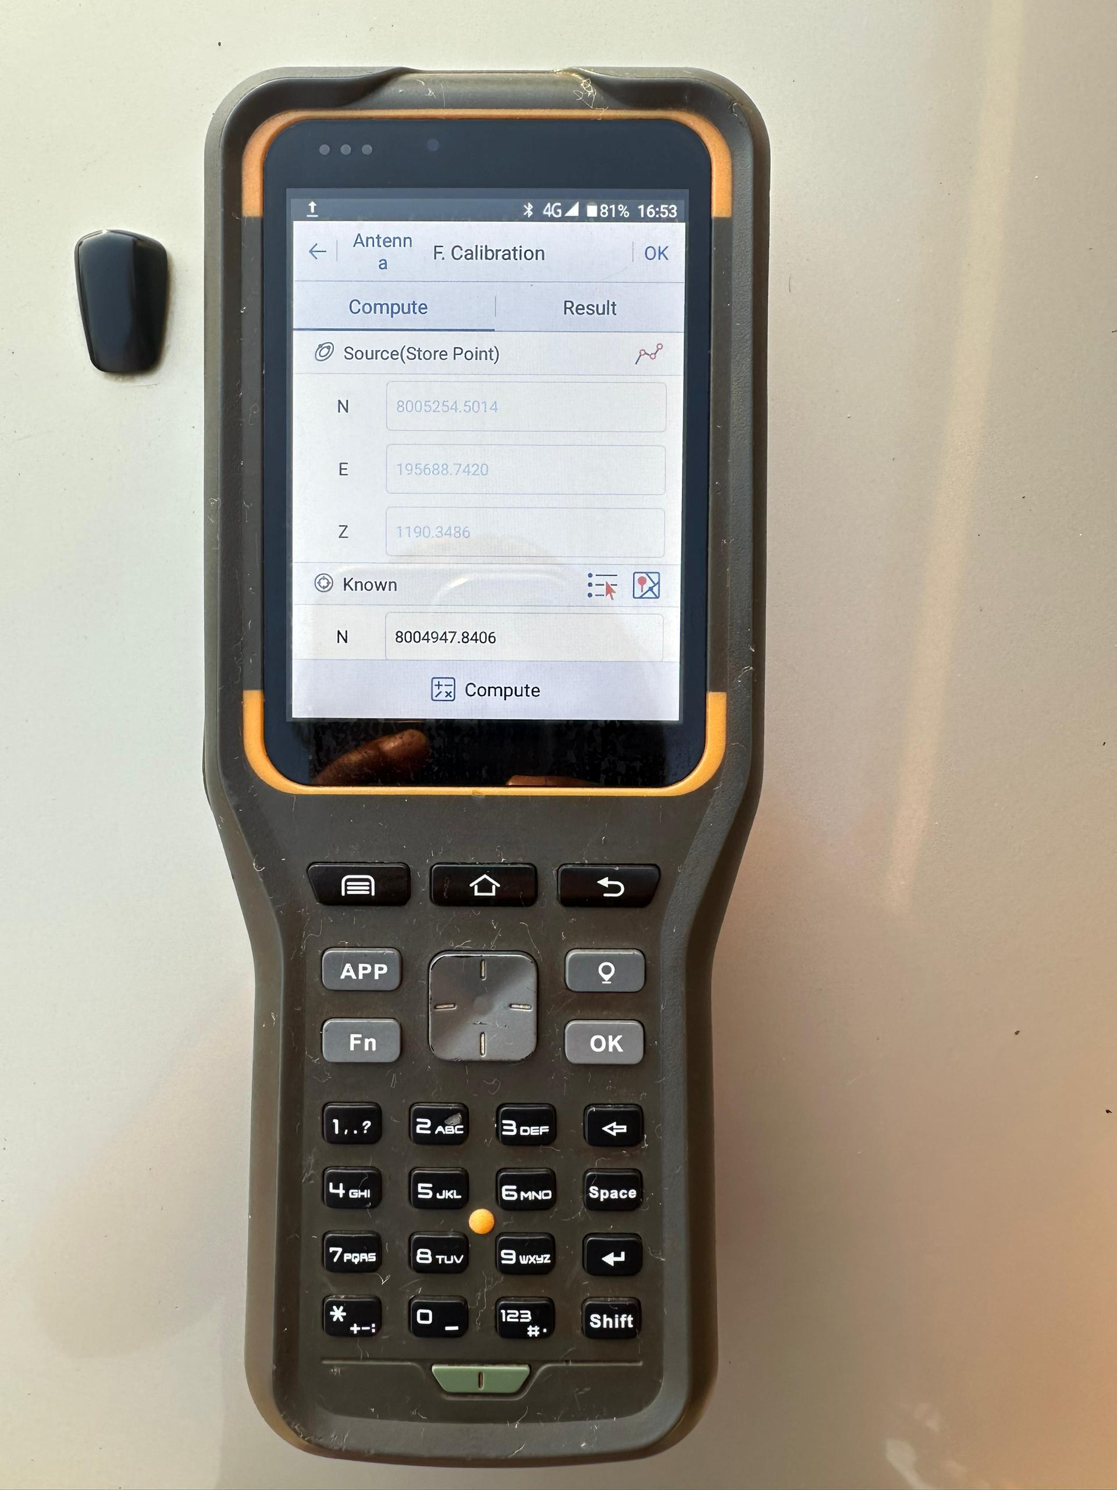
Base correction/ FRAMEWORK CALIBRATION
Step 1: open project settings
Set your rover on RP and collect data of the source point
Type in the correct coordinates of the RP and press compute
Notes:
Make sure to check with another reference point after base correction to insure accuracy. And always close your survey on a known point.

Slide 30
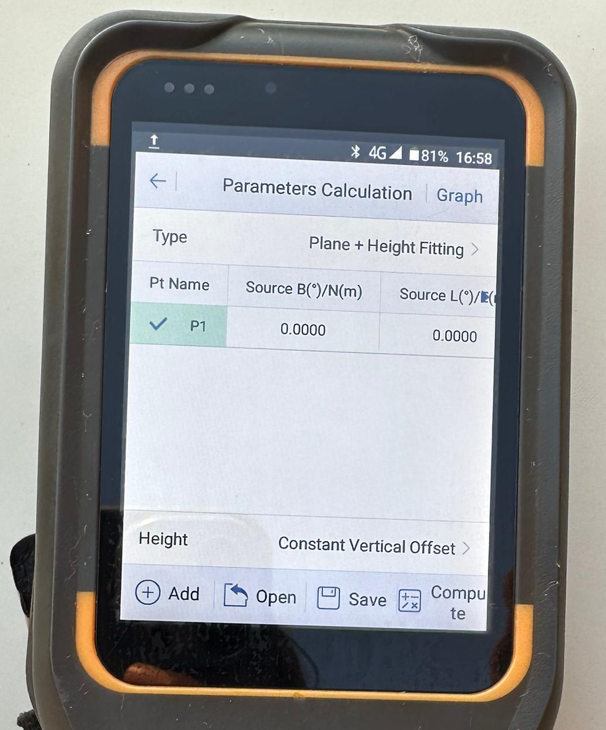
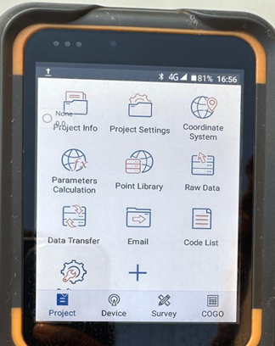
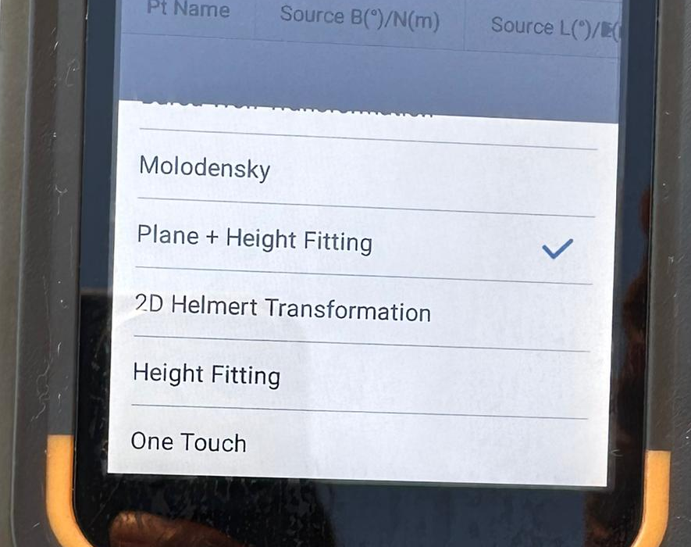
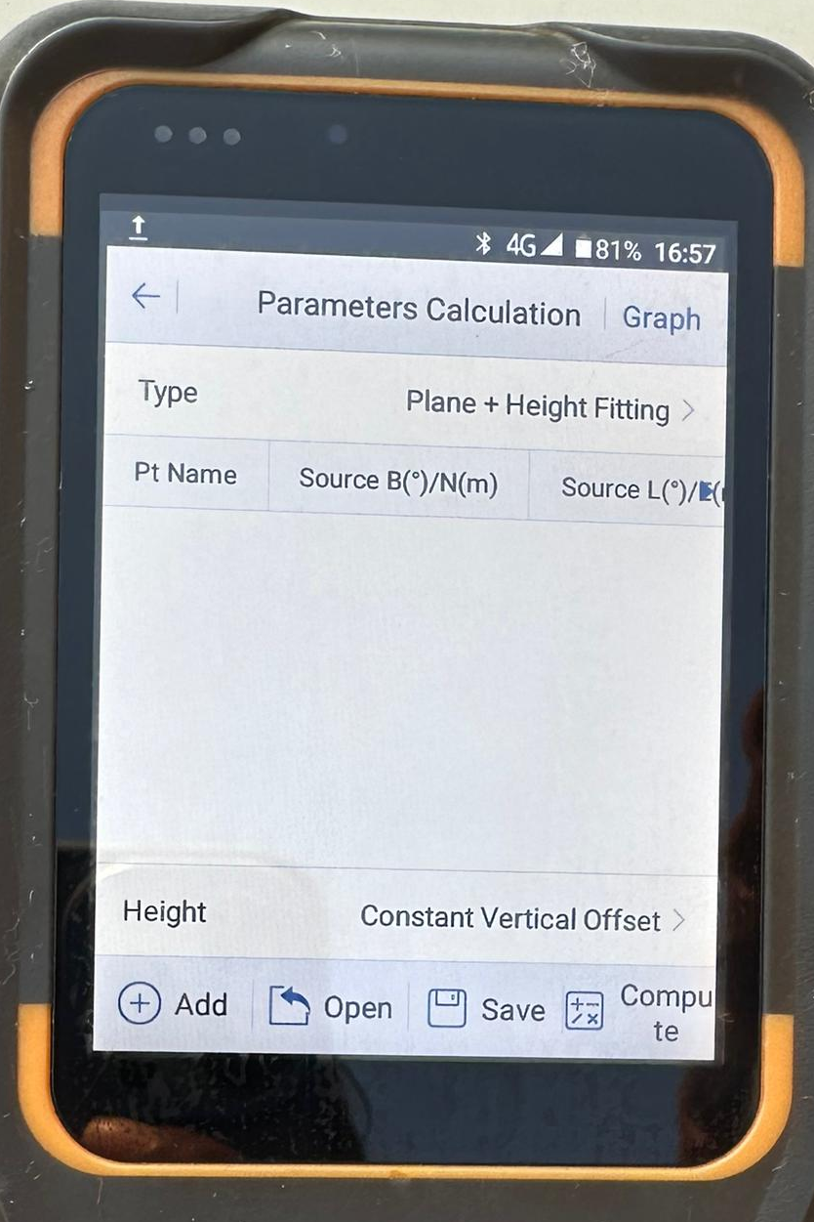
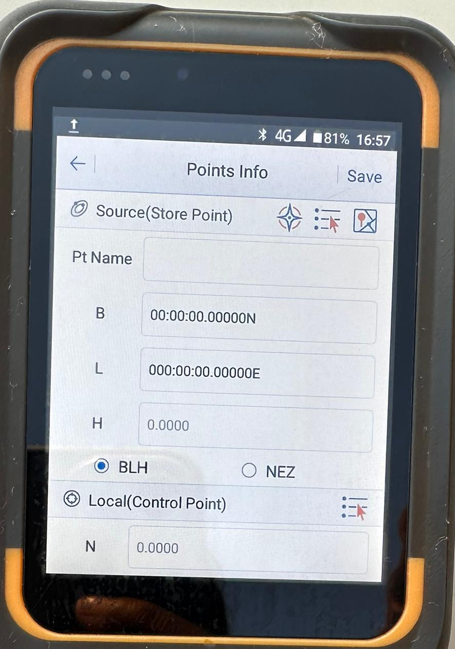
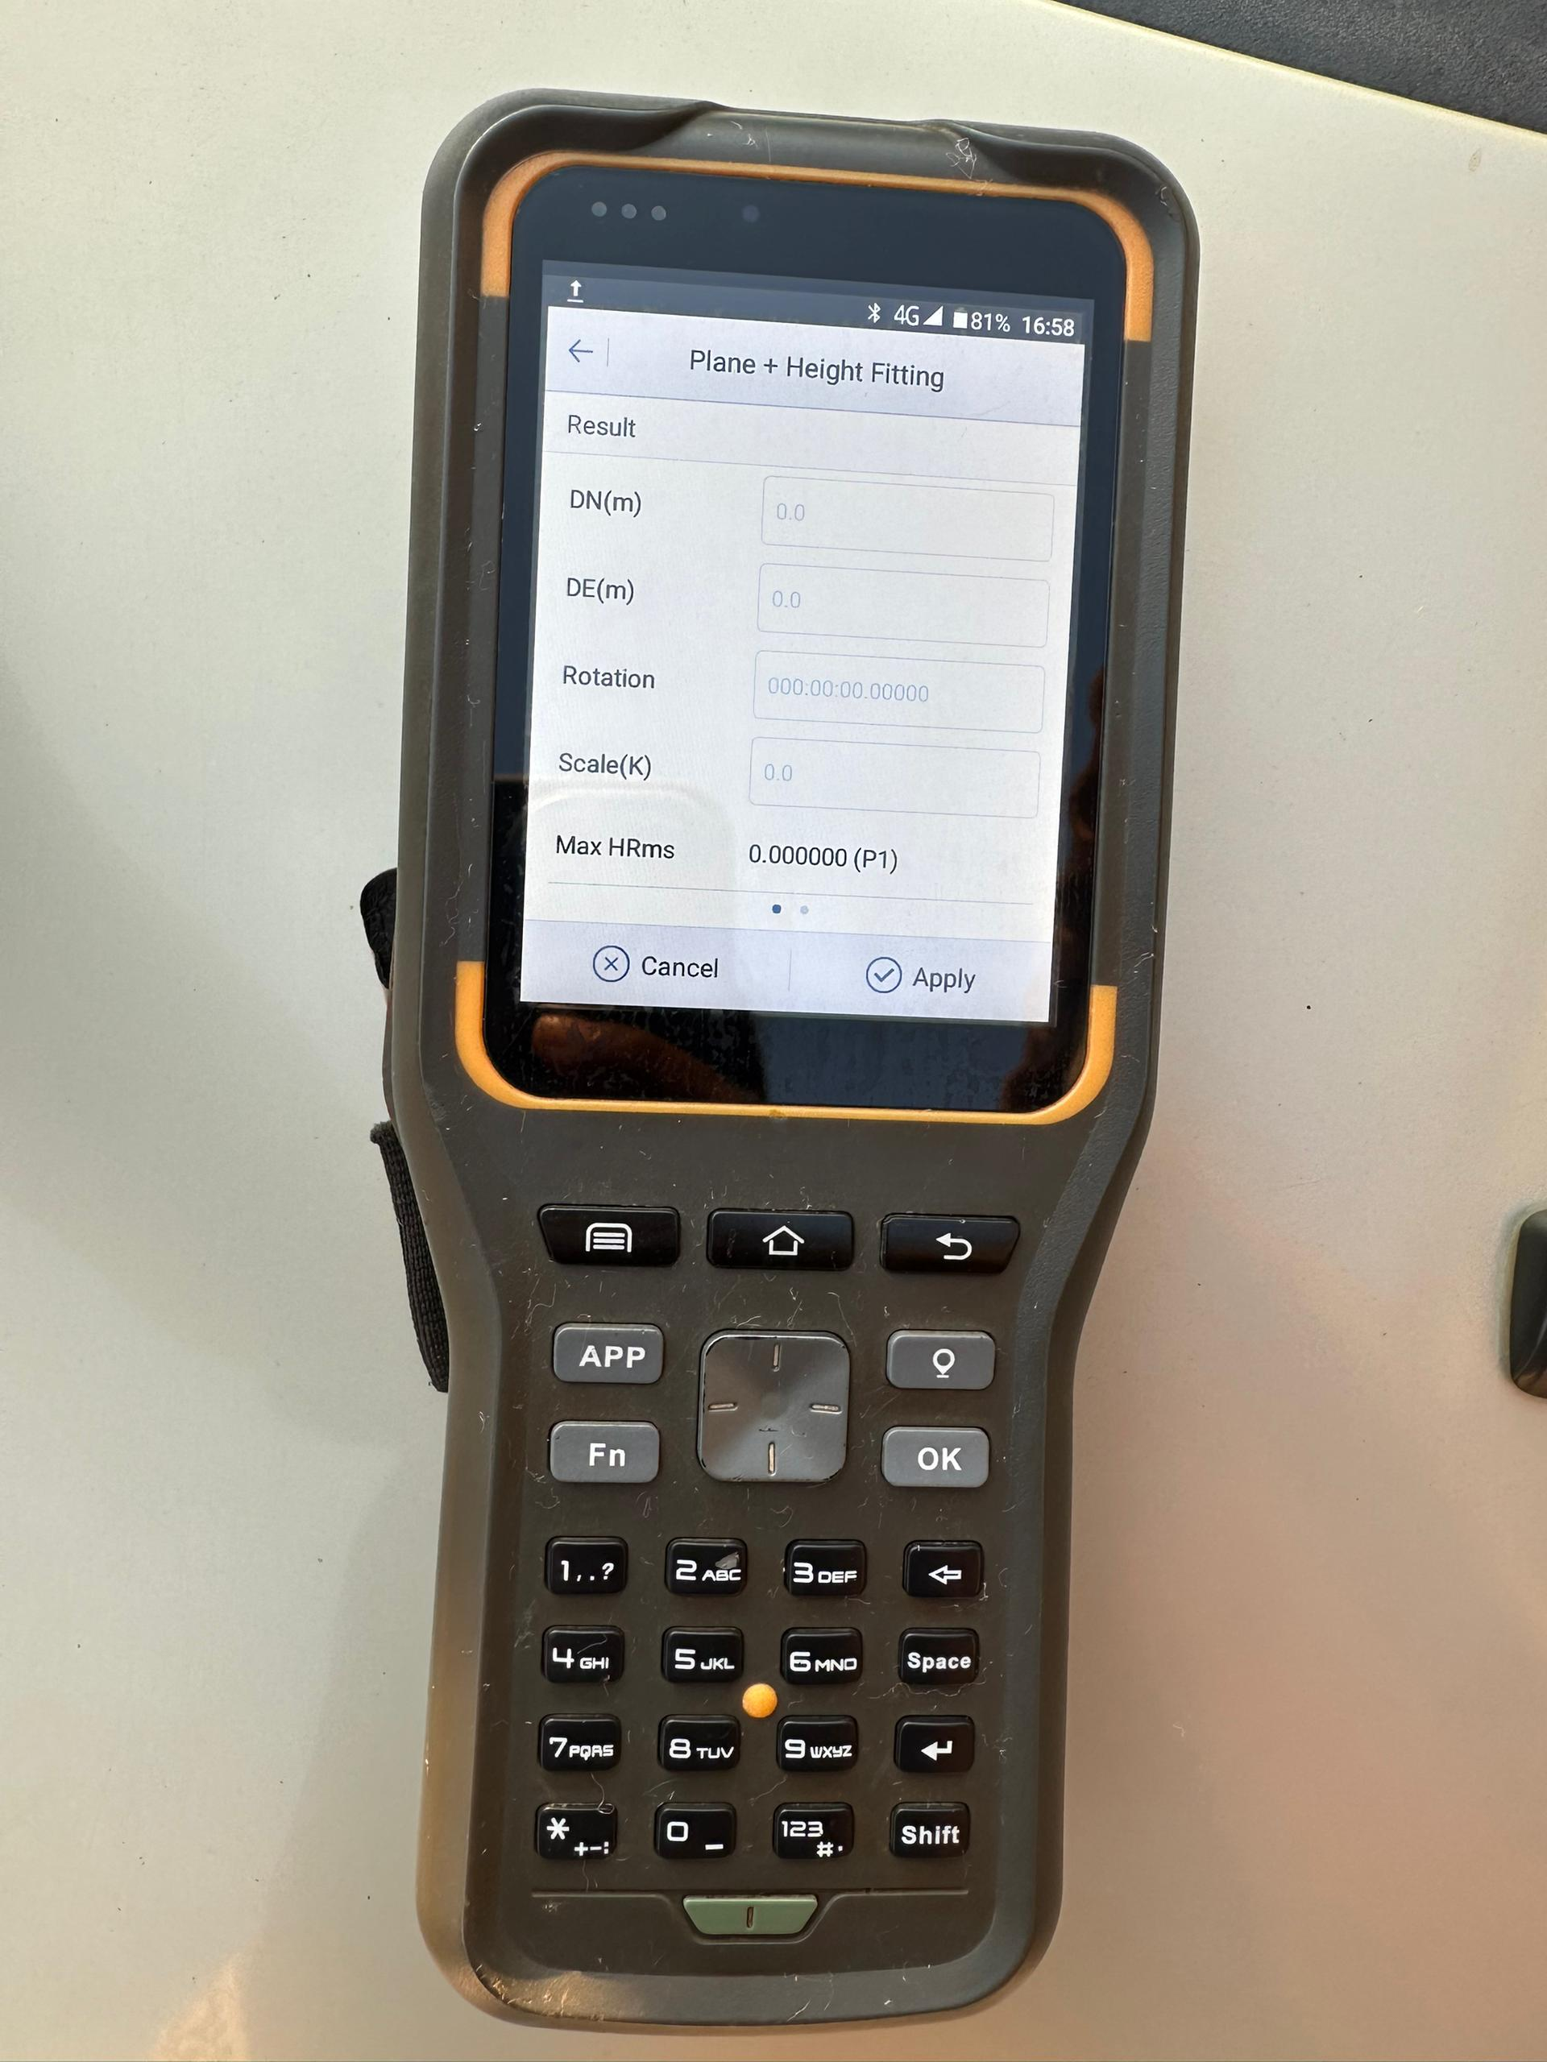
Site Calibration (Localization) PARAMETERS CALCULATION
STEP 1: Parameters Calculation
STEP 2: Select Parameters transformation type
STEP 5: go to next RP and repeat step 3 and 4 for all your reference points. When done press compute
STEP 6: if satisfied with the results then press apply
STEP 3:select add, type point name, Set your rover on RP and collect data of the source point
STEP 4: Type in the correct coordinates of the RP and press save
Notes:
If you are working in the same coordinate system as the reference points, rotation is almost 0 degrees and scale factor almost 1

Slide 31
Final tips & takeaways
Practice makes perfect
Continue improving
Consistent rehearsal
Trail surveys with your accustomed technic and the new acquired ones to check errors etc
Professional delivery
Reflect on performance
Explore new techniques
Iterate and adapt
Practice good survey habits

Slide 32
THANK YOU
ACKNOWLEDGEMENTS
AMSZ
Eve Zhou
Onai Munyati
Casper T Chikomo
Tapiwa Masunda
Mining Rabbi & Trampers Consultancy
www.miningrabbi.com
www.trampersmining.com

